Slide 1
Statistical Learning and Data Mining
Warm Up Assignment
Gaurav Gavali – 22060641065

Slide 2
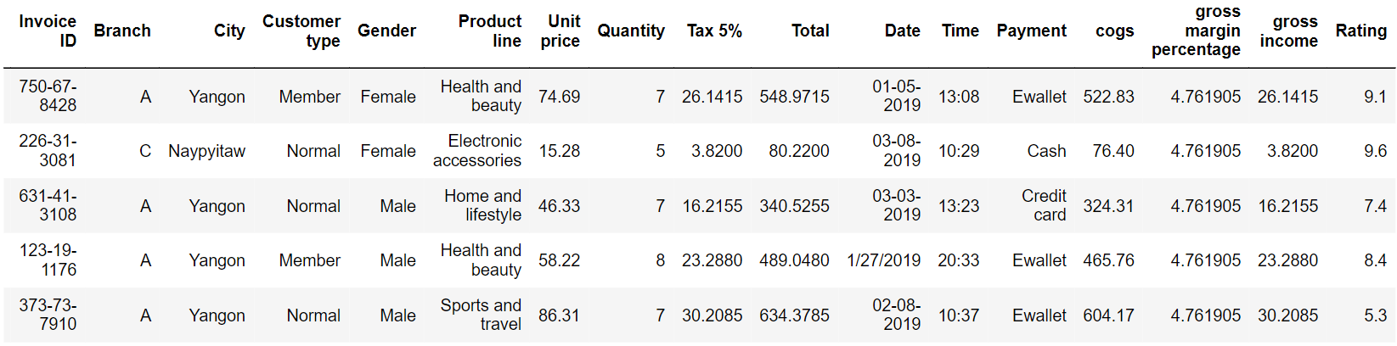
Question :
Supermarket sales:
The dataset consists of historical sales data of a supermarket company from 3 different branches over 3 months
a) Branch A (Yangoon)
b) Branch B (Mandalay)
c) Branch C (Naypyitaw)
Data:

Slide 3
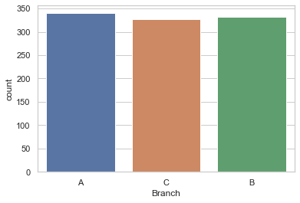
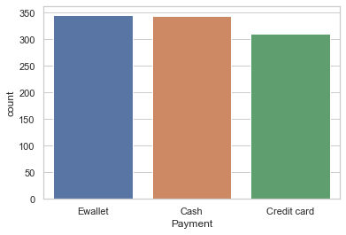
We will find out if there are any variations in the total sales throughout the branches. This can be achieved by a count plot.
The most popular payment method used by customers
There is not much difference in sales across the 3 branches of A, B and C.
The sales in branch A is a bit higher than the rest of the branches.
The most popular payment method is in-fact E-wallet and not credit cards.
Cash payment is also popular.

Slide 4
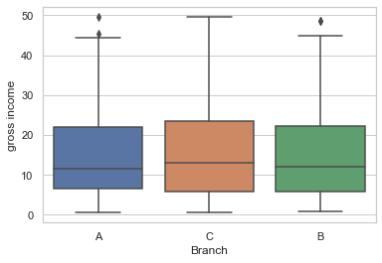
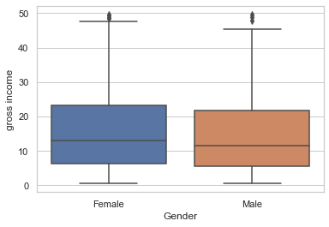
We will find out Which branch is the most profitable.
Relationship between Gender and Gross income.
There is not much difference in gross income by branches at an average level.
Branch C has a slightly higher income than A or B.
As observed earlier, though branch A has slightly higher sales than the rest,
C i.e. Naypyitaw is the most profitable branch in terms of gross income.
Gross income is similar for both male and female, though female customers spend a bit higher.

Slide 5
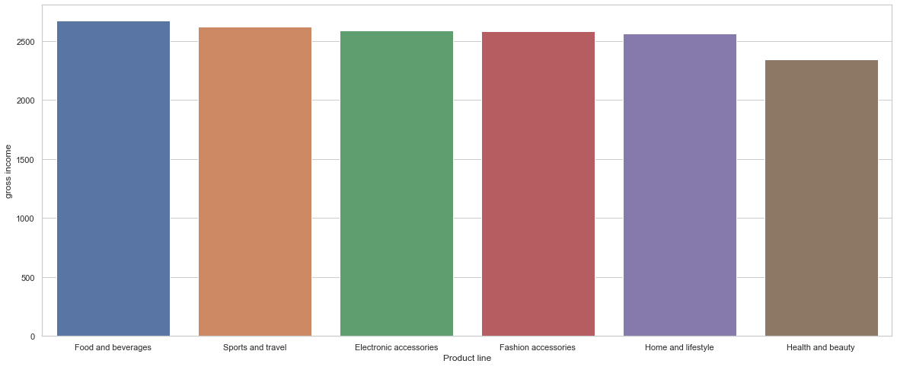
We will find out Which product line generates most income
From above graph we can see that gross income is highest in sports and travel.

Slide 6
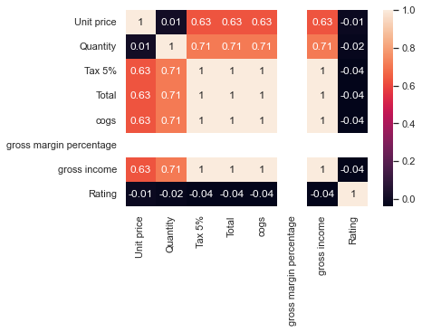
Correlation analysis
As we can see, unit price is positively correlated to cogs with 63% correlation.
Another interesting observation is that ‘Ratings’ hardly has any correlation with any other variables.
As is obvious, Quantity and gross income has very high correlation of 70%.

Slide 7
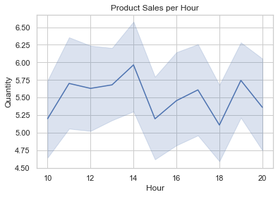
Now, we will find out which hour of the day is the busiest
From the graph we can see that peak is observed in the 14th hour i.e 2 pm of the day.
Hence, sales is typically higher in the afternoons.

Slide 8
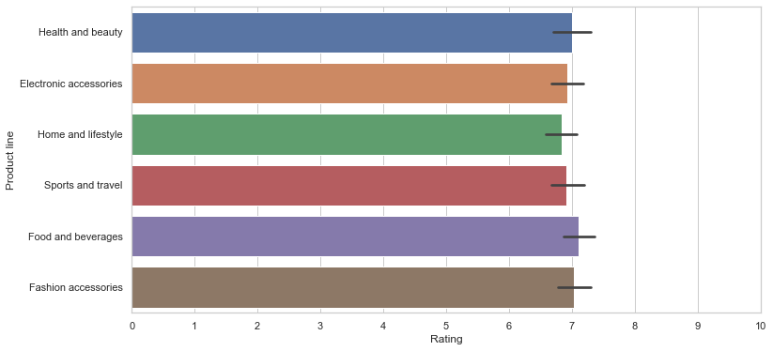
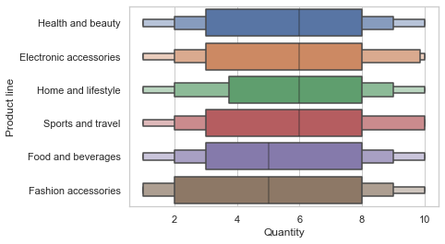
We will find out Which product line should the supermarket focus on
a) Rating of products: Rating is similar across products and at around 7.
b) Quantity purchased by product: The mean quantity is lower for ‘fashion accessories’ and ‘food and beverages’
Though the rating for ‘fashion accessories’ and ‘food and beverages’ is high but quantity purchased is low.
Hence, supply for these products need to be increased.

Slide 9
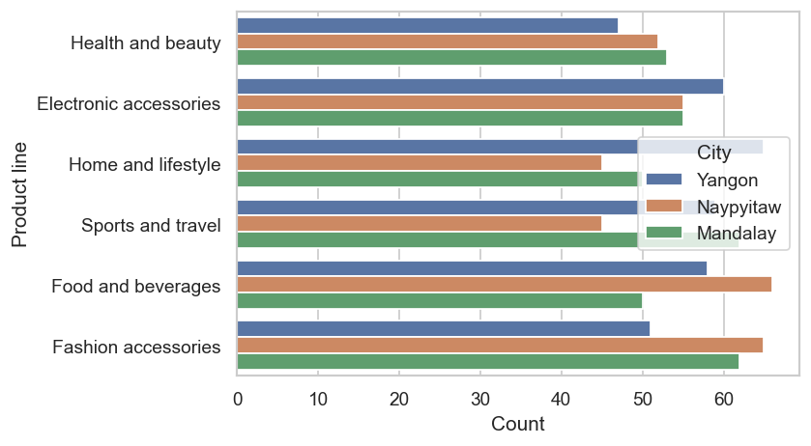
Sales of product across cities/Branches
Fashion accessories and food and beverages are the most sold product in Naypyitaw and these products should be focused on for expansion along with electronic accessories.

Slide 10
Conclusion:
The data consists of 3 cities/branches. Though branch A has slightly higher sales than the rest, C i.e. Naypyitaw is the most profitable branch in terms of gross income.
Fashion accessories and food and beverages are the most sold product in Naypyitaw and these products should be focused on along with electronic accessories.
The most popular payment method is E-wallet and cash payment is also on the higher side.
At an overall level, ‘Sports and Travel’ generates highest gross income.
Gross income is similar for both male and female, though female customers spend a bit higher. Females spend on ‘fashion accessories’ the most and for males surprisingly it is ‘Health and beauty’.
Using the correlation analysis, one interesting observation has emerged that customer ratings is not related to any variable.
Though the rating for ‘fashion accessories’ and ‘food and beverages’ is high but the quantity purchased is low. Hence, supply for these products need to be increased.

